Slide 1



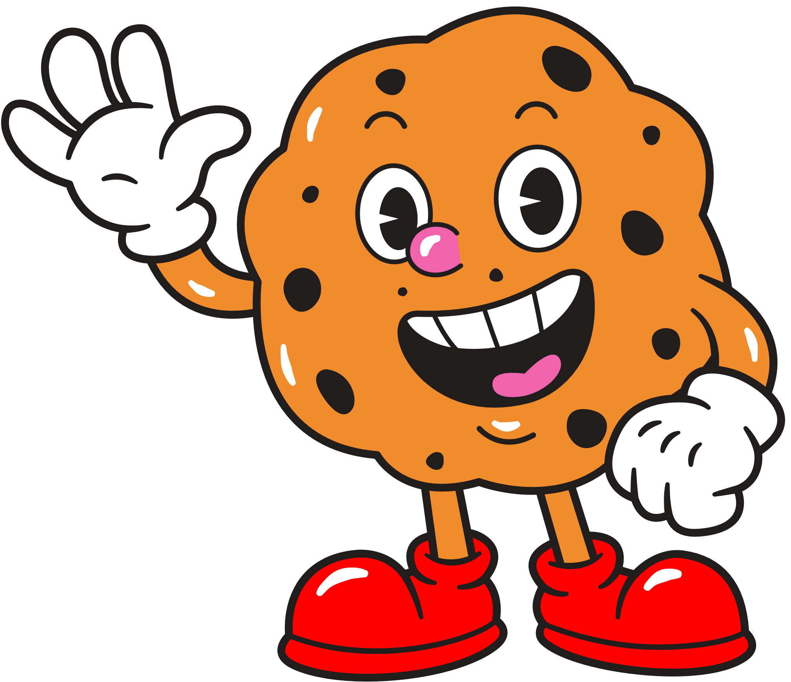







MARKETING
PROJECT
BISCONNI

Slide 2
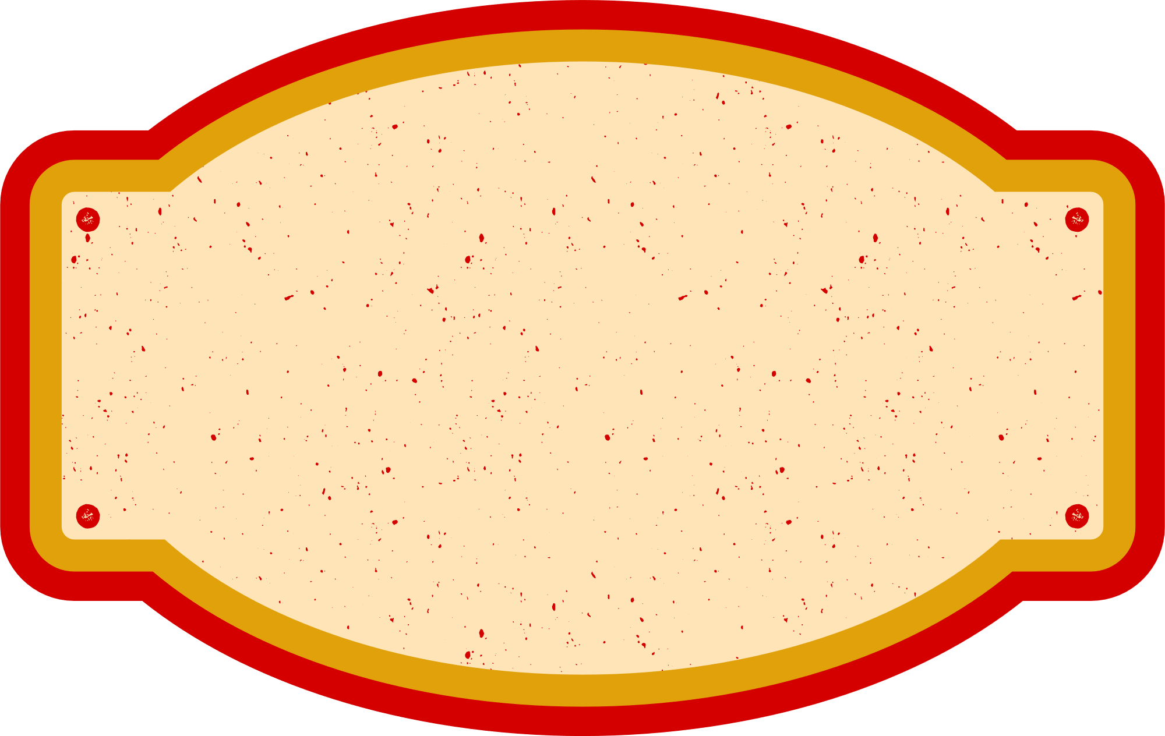




WHO WE ARE
OUR CULTURE
OUR INDUSTRY
WHAT MAKES US SPECIAL
We create a culture built around passion, innovation & people.
We are Pakistan’s Market Leaders of Chocolate and Confectionery industries.
Bisconni distinguishes itself through quality, variety, and innovative flavors.

Slide 3


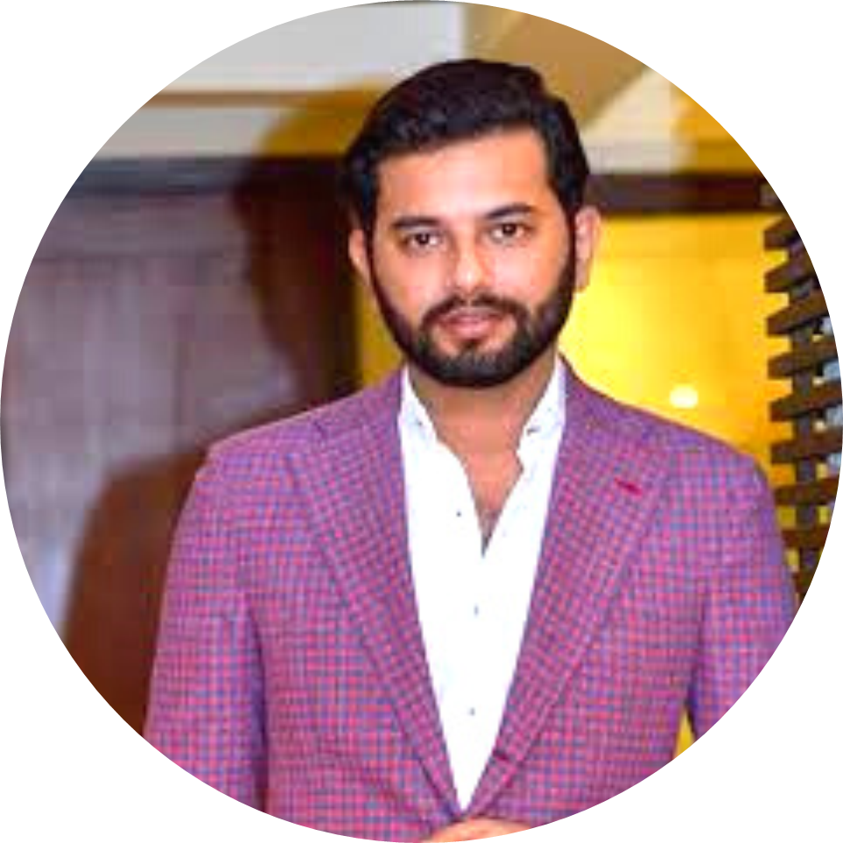


OUR CEO
Hamid Maqsood Ismail
“We are thrilled and driven by everything we do.
At Bisconni, open innovation plays a critical role in swiftly crafting quality products perfecting the art of baking. I am personally committed to pursuing measures incorporate innovation in our business. At the heart of our operation is a team of highly qualified professionals, each of whom was chosen for their commitment to excellence and dedication. We encourage members of the Bisconni family to excel within their roles and beyond to meet their full potential and be the best they can be. We provide a highly professional workplace culture providing a great learning platform for employees”

Slide 4




OUR EFFICIENT DEPARTMENTS AT
SALES AND ADVERTISING DEPARTMENT
MARKETING DEPARTMENT
BISCONNI
OPERATIONS AND SUPPLY CHAIN DEPARTMENT.

Slide 5

BISCONNI‘S VISION, MISSION AND GOALS
'To be a thought leader for the industry via innovative products to cater consumer's needs”
We aim for consistent product quality, maximizing value and customer satisfaction. Through effective utilization of people, technology, and management, we pursue profitable growth and fair returns for shareholders.
BISCONNI
“To allocate the brand in the minds of consumers to maximize the potential benefit to the firms. To provide good quality products to retain their customers.”

Slide 6

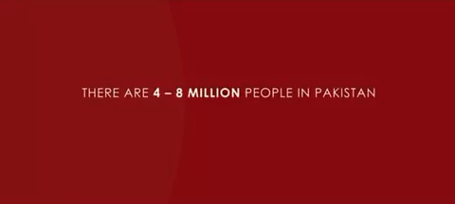

#CompleteOthers
WORLD CHILDREN’S DAY
Our
CSR Initiative
This campaign was carried out in collaboration with Bionik.org that designed exclusive bionic arms for these kids, bringing a new ray of sunshine in their lives.

Slide 7


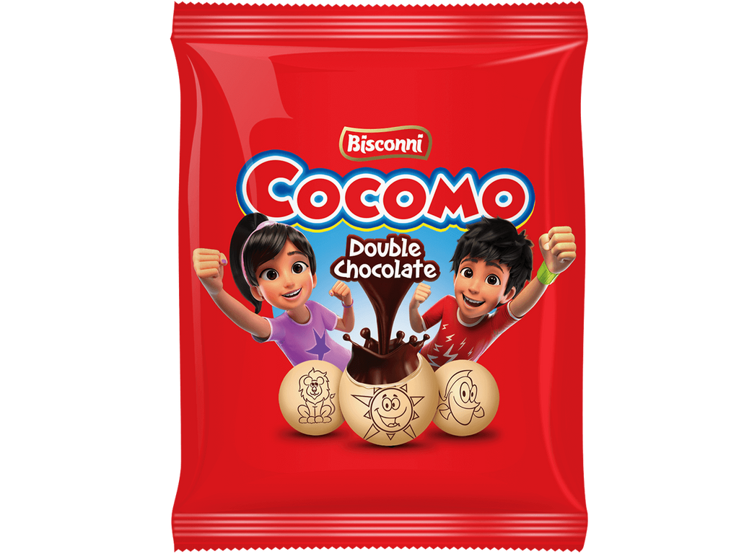
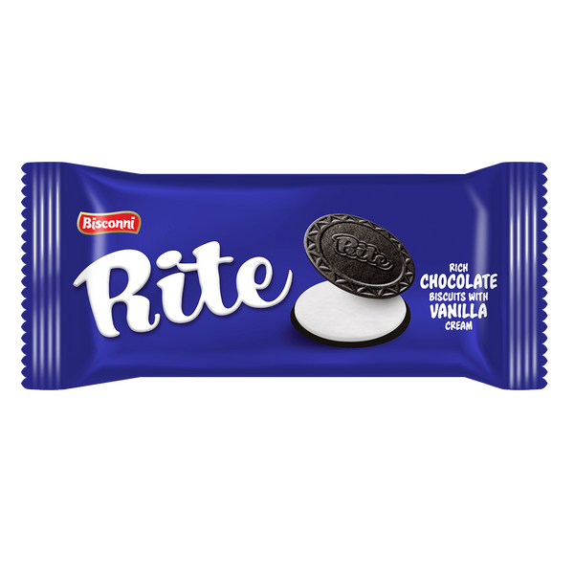

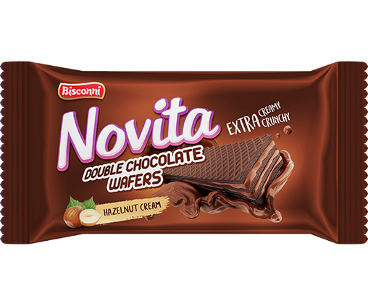
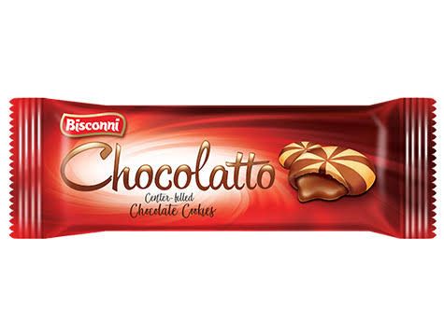
DONATE
DONATE
Rs.
10
DONATE
DONATE
DONATE
DONATE
OUR DONATIONS
DONATE
RS.1 from every RS.10 pack of our products.

Slide 8

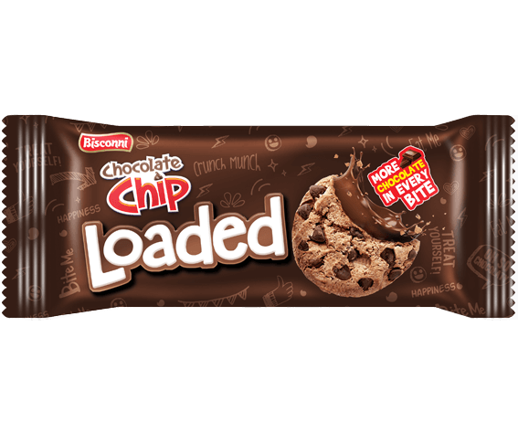
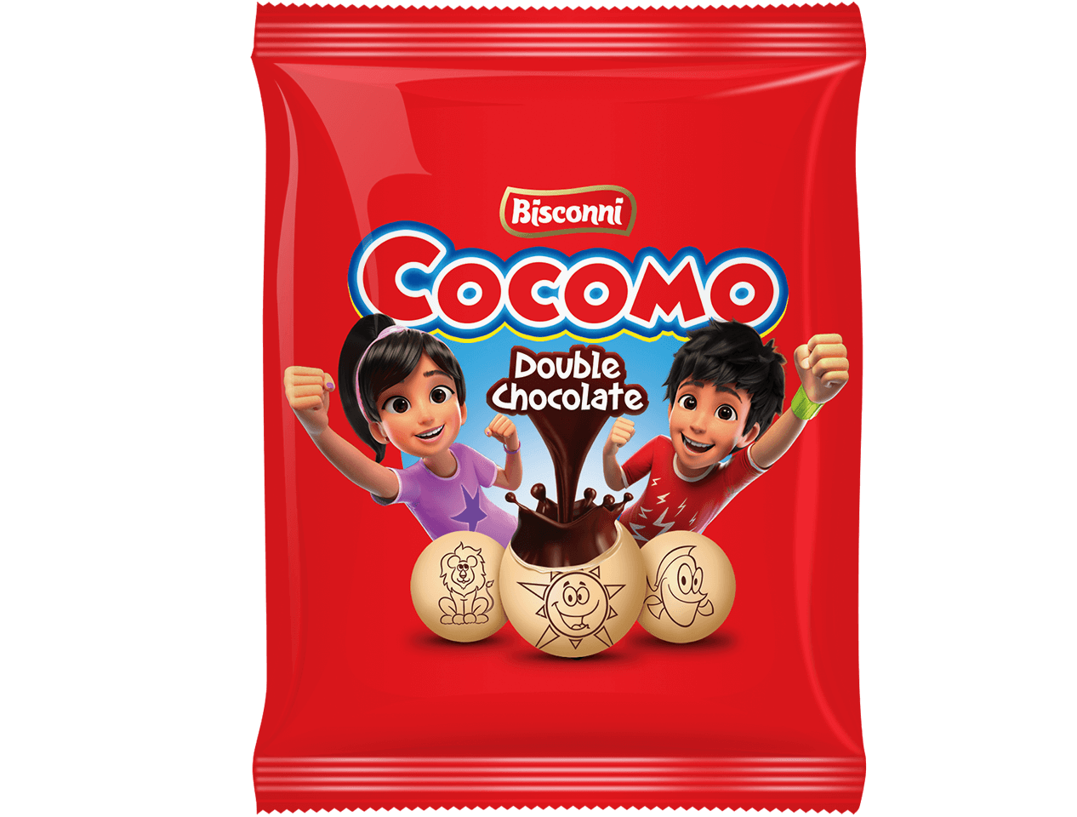
Bisconni’s Marketing Orientation
Market Orientation
Societal Orientation

Slide 9

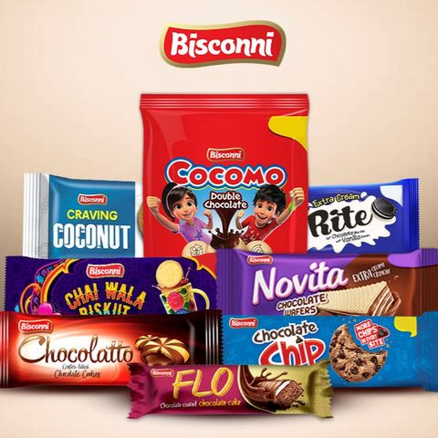
Business Portfolio
By BCG Matrix:
STAR COCOMO, CHOCOLATE CHIP | QUESTION MARKS RITE, FLO, CRAVING
CASH COWS CHOCOLATTO, NOVITA | DOGS CHAI WALA BISKUT, CRUX

Slide 10
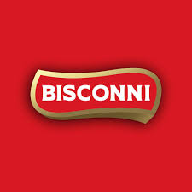

Micro And Macro
Marketing Environment
Internal Environmental Factors
External Environmental Factors
Natural Environment
Technological Environment
Political Environment
Cultural Environment

Slide 11
Bisconni has a market share of about 15% in the biscuit industry of Pakistan.

Slide 12
LU
(Mondelez International)
Direct
Competitors
English Biscuit Manufacturers (EBM)
Mayfair
(Asian Food Industries)

Slide 13
Snack food industry or biscuit brands which are likely smaller, local, or regional that cater to specific markets and could pose competition in specific segments or regions.
Supermarkets and retail chains may offer their own private-label biscuits, which compete indirectly with branded products.Consumers looking for cost-effective options may opt for these alternatives.
Indirect
Competitors

Slide 14
Strong brand heritage and recognition
Diverse portfolio/Wide range of products
Large and loyal customer base
Long history and experience in the biscuit industry
of products
Strong market position and leadership
Dedicated research and development team
State-of-the-art manufacturing facility
Unique positioning and differentiation in products
High-quality and affordable product portfolio
Growing market share and presence
Creative and engaging marketing and promotion strategy
Modern and flexible production facility
Competitive Advantage/
Key Features

Slide 15
Bisconni aims to cater to all segments of consumers, from children to adults, from urban to rural, and from low to high income.

Slide 16
Strengths:
Strong presence in confectionery and biscuits segments
Diverse product portfolio
Large and loyal customer base
State-of-the-art manufacturing facility
Well-established distribution network
Weaknesses:
Intense competition from other players
Cost pressures due to rising prices of raw materials and currency depreciation
Regulatory challenges due to taxes, duties, tariffs, and compliance issues
Opportunities:
Potential for growth in domestic and international markets
Opportunities for innovation and product development
Opportunities for expansion and diversification
Threats:
Threats from the external environment, such as political, economic, security, and natural issues
from the consumer behavior, such as shift in preferences, tastes, and lifestyles
from the legal and ethical issues, such as allegations of tax evasion, corruption, and environmental pollution

Slide 17
Bisconni has a wide and varied product mix,
with over 20 products and 5 product lines,
and also innovates and launches new products to meet the changing consumer needs and trends.
Products

Slide 18
Bisconni sets its prices
by adding a fixed percentage of profit margin to the total cost of production,
by considering the prices of its competitors,
by using odd numbers such as PKR 9.99, PKR 19.99, or PKR 49.99 to create a perception of value and affordability.
Pricing

Slide 19
Bisconni sells its products in Pakistan and worldwide, using direct, indirect, and hybrid channels.
Bisconni uses both retailing and wholesaling methods to reach its customers.
Place

Slide 20
Catchy slogans, cartoon characters.
Launched a campaign called “Cocomo Moo Factory” (chance to win from a biscuit wrapper)
Sponsor events and activities, such as festivals, concerts, and exhibitions.
Email, SMS, social media, and mobile apps.
Discounts (seasonal, festivals/events, bulk & bundle)
“Cocomo mujhe bhi do”
Promotion

